Slide 1
Flow Collectibles Tracker
P/L + Alerts + Action for Flow collectibles
Performance-first portfolio tracking for Flow collectibles
Unify holdings, P/L, liquidity insights, and alerts across the Flow collectibles ecosystem.

Slide 2
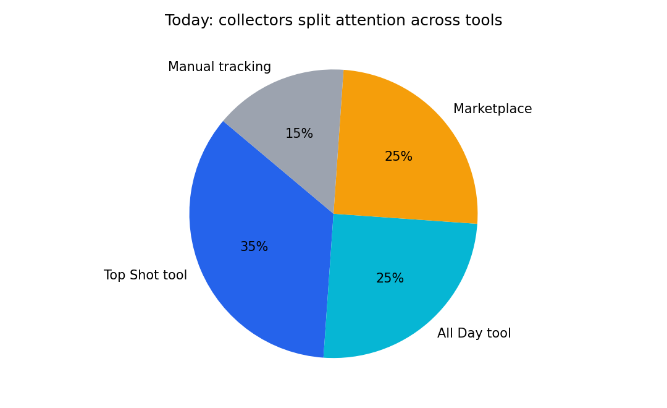
Problem
Collectors are fragmented across tools and marketplaces
What collectors experience
Multiple sites for listings, comps, and portfolio views
Holdings are visible but performance (P/L) is unclear
Action signals are missed (undercuts, floor breaks, big sales)

Slide 3
Solution
One wallet view + P/L + alerts + recommended actions
What we deliver
Unified holdings across key Flow collectibles
Real-time portfolio value + cost basis P/L
Alerts that drive action (undercut, floor moves, liquidity)
Shareable portfolio pages/cards for community growth
Before
After
Multiple sites and logins
Unclear P/L and cost basis
Missed undercuts and floor moves
One wallet view
P/L + performance first
Alerts + recommended actions

Slide 4
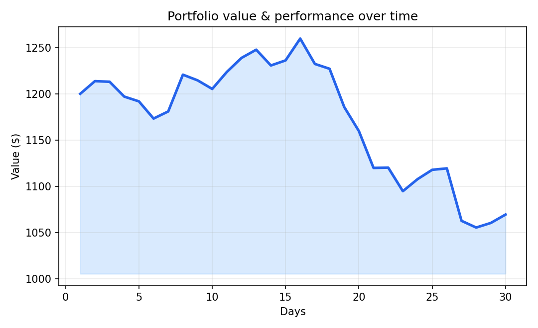
Value to users
Why collectors return daily/weekly
Core user value
Clarity: total value and P/L in seconds
Confidence: alerts + liquidity insights support better decisions
Convenience: one home for performance across the ecosystem
Sharing: portfolio cards that spread organically

Slide 5
Differentiation
Not another dashboard — a performance + action layer
What exists today
Vertical tools: OTM, AddMoreFunds, AllDay.tools
General trackers: FLOLiO, Dice2Moon
Marketplaces: Flowty (buy/sell, loans/rentals)
Often data-heavy without a clear action layer
Our wedge
P/L + cost basis as the primary UI
Alerts + recommended actions
Cross-market comps + liquidity signals
Shareable portfolio pages (viral loop)

Slide 6
Why it matters for Flow
Retention, liquidity, and better end-user UX
Ecosystem impact
Retention: collectors check performance and alerts repeatedly
Liquidity: better comps + signals increase healthy marketplace activity
Catalog narrative: supports the open, interoperable Flow NFT standard
Complements on-ramps like Flowramp (buy → track → optimize → transact)
Retention
Habit loop via alerts + P/L
Liquidity
Better comps → more listings + buys
Onboarding
Shareable portfolio pages

Slide 7
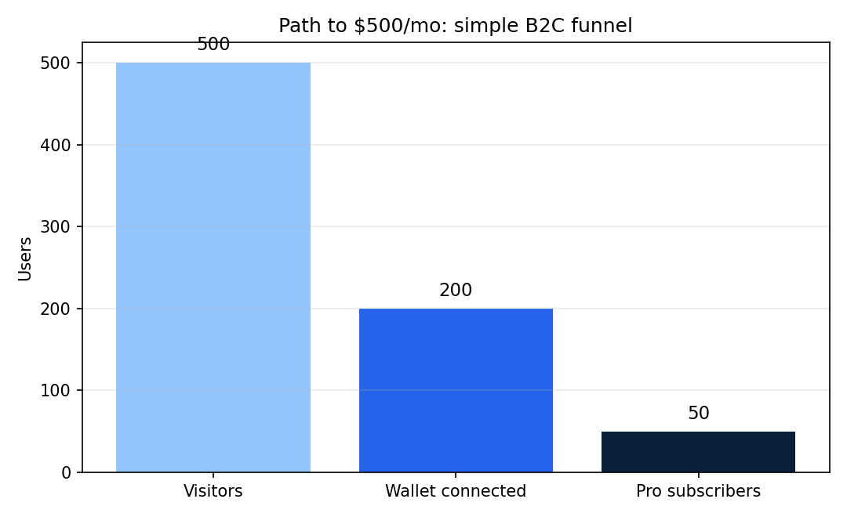
Business model + go-to-market
Simple subscription with a clear distribution loop
Sustainability
Freemium: basic view free; Pro ($7–$15/mo) for real-time, alerts, and P/L
Moat: normalized pricing data + saved alerts/workflows + trusted collector brand
Distribution: collector communities → share cards → wallet/marketplace partnerships
Goal: 500 free users → 50 Pro users (~$500/mo)

